Slide 1


Final States
Allowed
Not Allowed
Final states have no outgoing transitions
In a final state the machine halts

Slide 2
Acceptance
If machine halts
in a final state
Accept Input
If machine halts
in a non-final state
or
If machine enters
an infinite loop
Reject Input

Slide 3



Turing Machine Example
A Turing machine that accepts the language:

Slide 4


Time 0

Slide 5
Time 1

Slide 6
Time 2

Slide 7
Time 3

Slide 8

Time 4
Halt & Accept

Slide 9

Rejection Example
Time 0

Slide 10
Time 1
No possible Transition
Halt & Reject

Slide 11

Language?

Slide 12
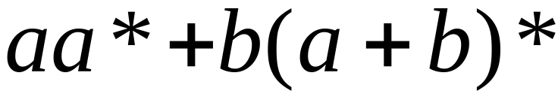
Infinite Loop Example
A Turing machine
for language

Slide 13
Time 0

Slide 14
Time 1

Slide 15
Time 2

Slide 16
Time 2
Time 3
Infinite loop
Time 4
Time 5

Slide 17
Because of the infinite loop:
  The final state cannot be reached
  The machine never halts
  The input is not accepted

Slide 18
Turing machine halting problem

Slide 19
Definition:
A language is recursively enumerable
if some Turing machine accepts it

Slide 20





Let be a recursively enumerable language
and the Turing Machine that accepts it
For string :
if
then halts in a final state
if
then halts in a non-final state
or loops forever

Slide 21
Definition:
A language is recursive
if some Turing machine accepts it
and halts on any input string
In other words:
A language is recursive if there is
a membership algorithm for it

Slide 22
Let be a recursive language
and the Turing Machine that accepts it
For string :
if
then halts in a final state
if
then halts in a non-final state

Slide 23

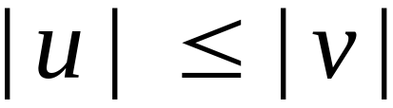
Context-Sensitive Grammars:
Productions
String of variables
and terminals
String of variables
and terminals
and:

Slide 24
Context sensitive grammars
Context-sensitive production: any production α → β satisfying |α| ≤ |β|. (α , β )€ (VUT)+
Context-sensitive grammar: Any CFG without epsilon (Ɛ )production CSG
Every CSG is not CFG

Slide 25
The Chomsky Hierarchy

Slide 26
Unrestricted Grammars:
Productions
String of variables
and terminals
String of variables
and terminals
A grammar G =(V, T, S, P) is called unrestricted if all the productions are of the form u → v, where u is in (V ∪ T) + and v is in (V ∪ T)*.

Slide 27
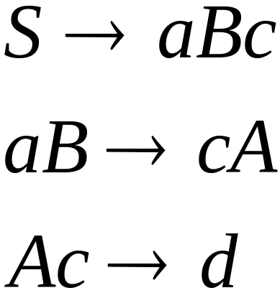
Example for an unrestricted grammar:

Slide 28
The Chomsky Hierarchy
All formal languages
Recursively-enumerable
Recursive
Context-sensitive
Context-free
Regular

Slide 29

Language generated?
Generates {a^{i}b^{j}c^{i}d^{j}|i, j ≥ 1}

Slide 30

Language generated?

Slide 31

Generates {a^{i}b^{j}c^{k}|1 ≤ i ≤ j ≤ k}

Slide 32
D->DB
D->B
X1A1->aX1
X1B->bX2
X2B->bX2
X2A2->aX3
X3A2->aX3
X3B->bX4
X4B->bX4
X4A3->aX5
X5A3->aX5
X5X6->aa
Grammar for {a^{n}b^{j}a^{n}b^{k}a^{n}|1 ≤ j, k, n}
S->X1YZA1TA2X6
T->A1TA2A3
T->A1A2
A3A2->A2A3
ZA1->A1Z
ZA2->A2Z
YA1->A1Y
A1YA2->A1CA2
A2ZA3->A2DA3
C->CB
C->B

